Slide 1


Toggle Service Sample #Sara Silva

Slide 2
Agenda
Context
Feature Toggle Overview
Toggle Service solution
Aditional References

Slide 3
Context
This presentation has the goal to expose the solution related with the “Toggle Service Exercise” provided.
“Company ​ X P T O ​ has a digital platform built under SOA and currently with 62 services/applications built within. All new features are implemented with system toggle so they can quickly deliver new value, and if something goes wrong, they just toggle it off. Currently, whenever ​ X P T O
​needs to change the toggle values in live, they need to change a file with the toggle properties values and restart the service/application so it can take effect.”
…

Slide 4
Feature Toggle Overview

Slide 5
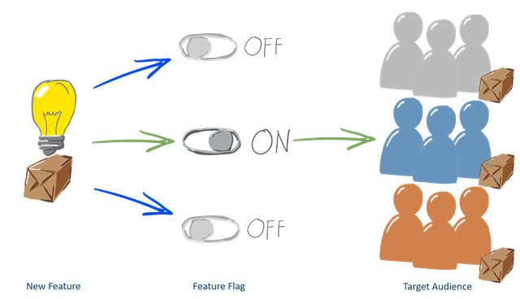
Feature Toggle Overview
A feature toggle (also feature switch, feature flag, feature flipper, conditional feature, etc.) is a technique in software development that attempts to provide an alternative to maintaining multiple source-code branches (known as feature branches), such that the feature can be tested, even before it is completed and ready for release.
Feature toggle is used to hide, enable or disable the features, …
https://en.wikipedia.org/wiki/Feature_toggle
Notes:
Feature toggles require a robust engineering process, solid technical design and a mature toggle life-cycle management.
Without these 3 key considerations, use of feature toggles can be counter-productive.
Remember the main purpose of toggles is to perform release with minimum risk, once release is complete toggles need to be removed.
https://writeabout.net/2016/12/21/there-is-no-devops-without-feature-flags/
https://en.wikipedia.org/wiki/Feature_toggle

Slide 6
Feature Toggle Overview
A framework for “feature flags” should:
Allow the management of the flags outside of your application
Allow you to change the configuration during runtime without any downtime
Switch the configuration at once (on all servers and in all components)
Have a minimal fingerprint / a very high performance
Be failsafe (return a default value when the service is not available)
Allow you to change the configuration per user, machine, percentage
Implementing a framework that meets these requirements is pretty complex.
by Michael Kaufmann
http://bit.ly/2izyY1s
Notes:
Possible Solution: http://docs.launchdarkly.com/docs/creating-a-feature-flag
https://writeabout.net/2016/12/21/there-is-no-devops-without-feature-flags/
https://en.wikipedia.org/wiki/Feature_toggle

Slide 7
Managing Features - Frameworks
“There are a lot of open source frameworks for the different languages. For Java there are Togglz, FF4J, Fitchy and Flip. For .Net there are FeatureSwitcher, NFeature, FlipIt, FeatureToggle or FeatureBee. Some use strings, some enums and some classes – but none has a high scalable backend and a portal to manage your flags (at least not that I know).
That’s why I played around with LaunchDarkly the last months. This is not just a framework – it’s a complete “feature flag as a service” solution. It has a SDK for .Net, Java, Python, Ruby, Go, Node, JavaScript, iOS, Android and PHP. It has a portal to manage your flags and to set up experiments. It integrates with VSTS and BitBucket Pipelines, with Slack and HipChat, with Optimizley and New Relic.”
by Michael Kaufmann
http://bit.ly/2izyY1s

Slide 8
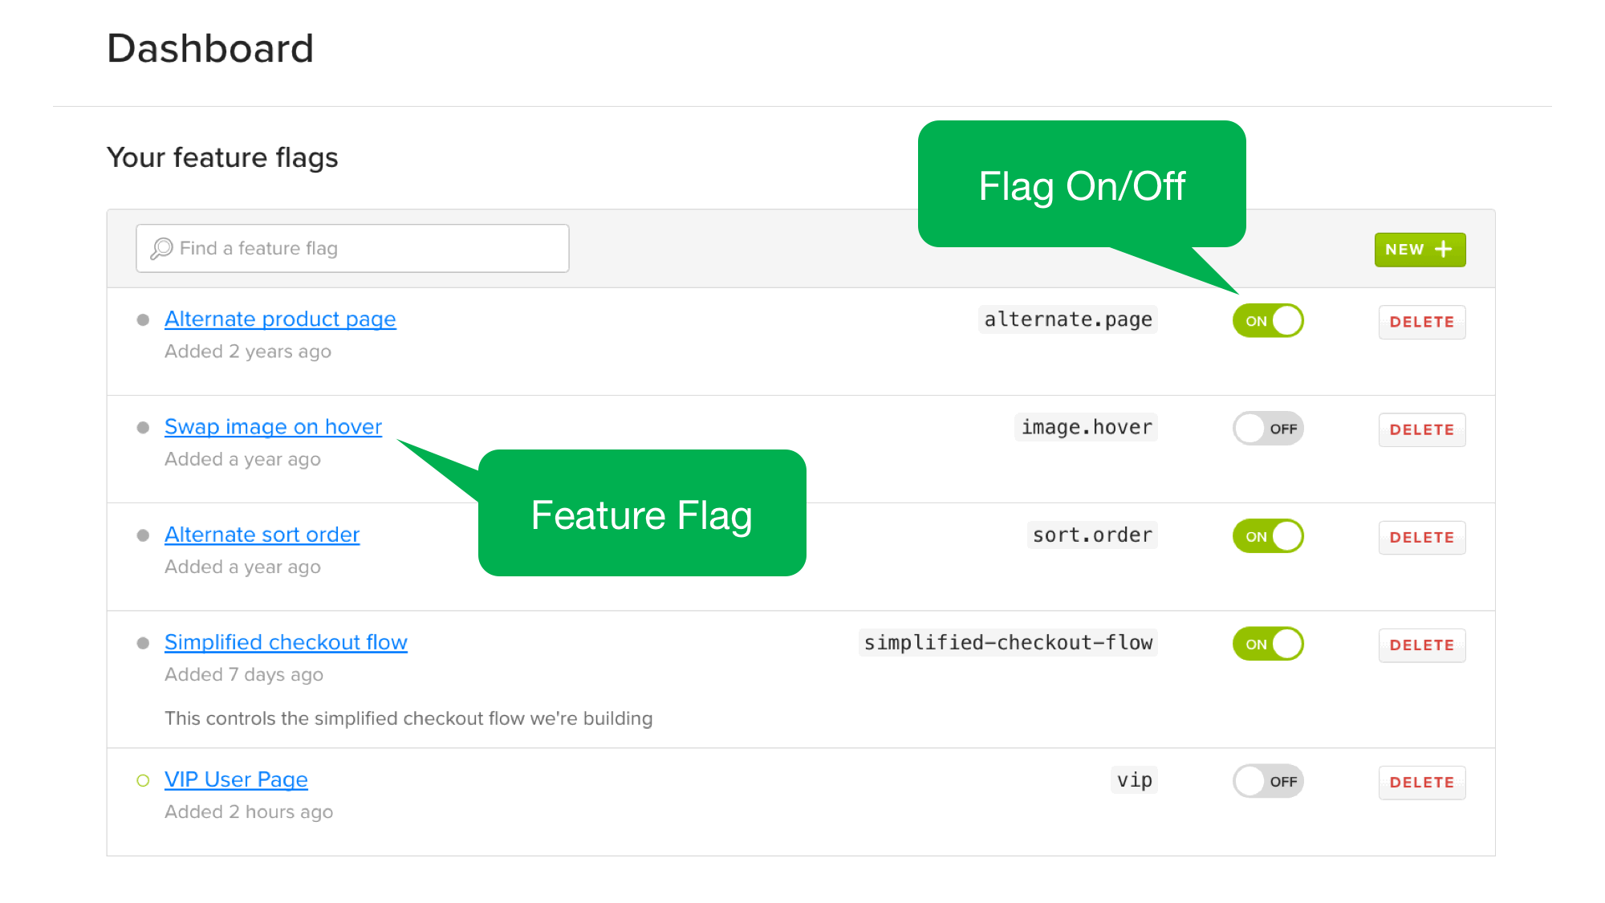
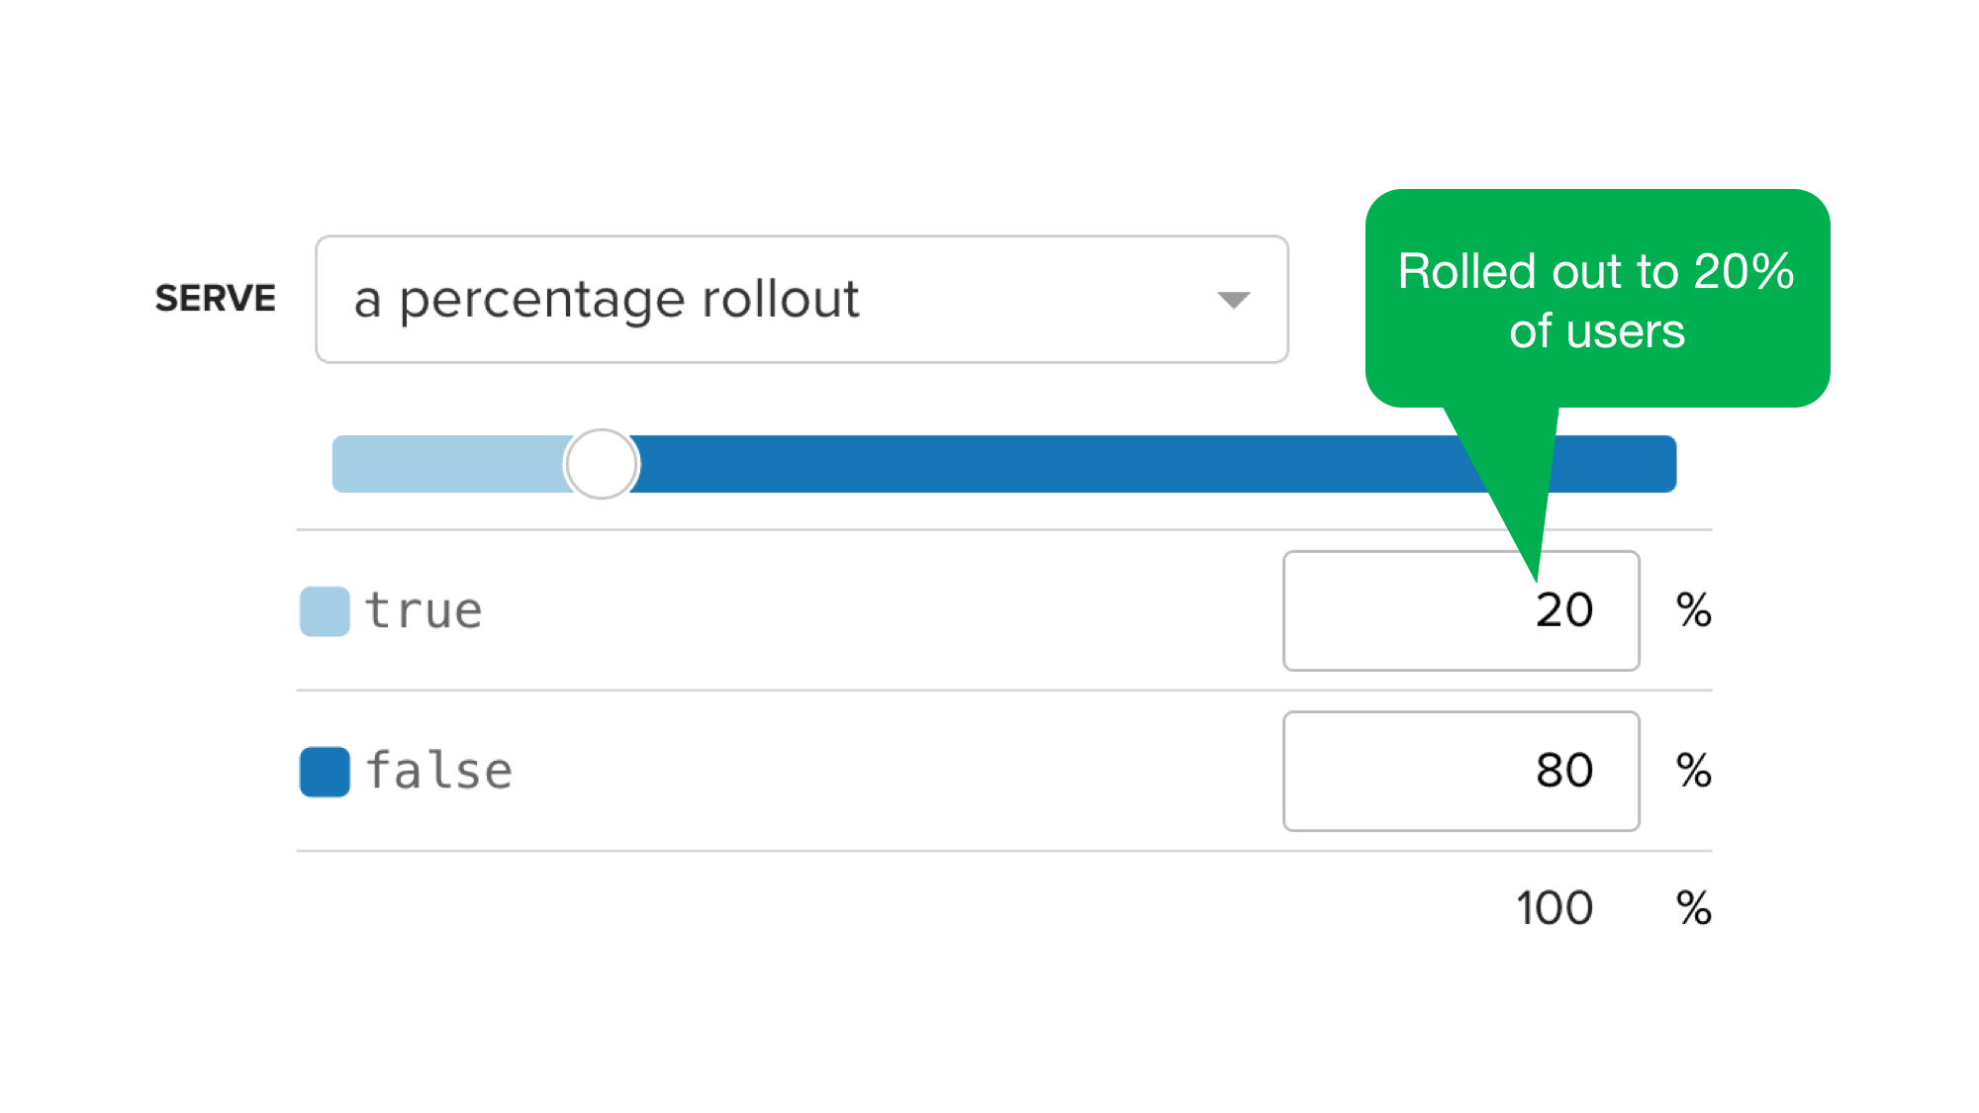
Managing Features - Frameworks
nToggle found in 06/12
FeatureToggle found in 06/12
NFeature found in 06/12
Toggler found at 12/12/12
Flipper found at 01/01/13
Switcheroo found at 01/13/13
FlipIt found at 01/13/13
c24.FeatureSwitcher found at 12/07/13
OnOff found at 01/12/14
FeatureToggler found at 08/12/14
Moon.Features found at 09/14/14
FeatureSwitch found at 09/14/14
FeatureFlipper found at 09/14/14
ReallySimpleFeatureToggle found at 09/14/14
FeatureBee found at 09/14/14
Togglr found at 09/14/14
toggler.net found at 09/14/14
Ensign found at 09/14/14
Fooidity found at 11/06/14
FeatureSwitch found at 12/25/14
DevCookie found at 7/1/16
LaunchDarkly - Feature flag management software designed for teams.
Launch → Control → Measure your features

Slide 9
Considerations
Feature toggles require a robust engineering process, solid technical design and a mature toggle life-cycle management.
Without these 3 key considerations, use of feature toggles can be counter-productive.
Remember the main purpose of toggles is to perform release with minimum risk, once release is complete toggles need to be removed.

Slide 10
Feature Toggle - Mobile App’s Flow
Spalsh
Screen
User do the login
Login
After login we have the user’s data and all features
App based on
features
User did the login and has a session
Auth
Get features
Cloud
Loading
SplashScreen
Get features

Slide 11
Toogle Service Solution

Slide 12
References
The references related with the exercise developed are
The source code
https://github.com/saramgsilva/ToogleServiceSample
Platform running on Azure (Web Apps) & Azure Database
http://toggleserviceplatform.azurewebsites.net/

Slide 13
How to run
Go to ToggleServiceSample\src
Open CompanyXPTO.ToggleService.sln
Define CompanyXPTO.ToggleService.Platform as “Startup Project”
Open the WebConfig and define the connection string
Apply migration(*) using update-database (database and tables will be created, and the seed da ta is applied with initial data.
(*) The solution is using EF Code First

Slide 14
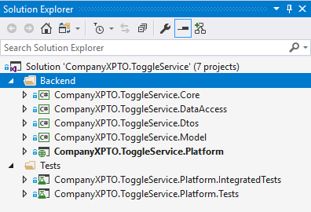
The solution
The solution has two solution folders – Backend & Tests
Backend folder contains all projects that define the platform.
Tests folder contains all projects that defines the de tests created.

Slide 15
The solution
Project’s name | Description
CompanyXPTO.ToggleService.Core | Contains the classes that defines the business logic from the platform – these classes can be used by Service or by MVC Controllers.
CompanyXPTO.ToggleService.DataAccess | Contains all classes to access data from data base - DBContext, Repository Pattern, UnitOfWork, ….
CompanyXPTO.ToggleService.Dtos | Contains all classes that defines by data object transfer from the platform.
CompanyXPTO.ToggleService.Model | Contains all classes that defines the model which is used by DataAccess Layer.
CompanyXPTO.ToggleService.Platform | ASP.Net MVC & WEBAPI project
CompanyXPTO.ToggleService.Platform.IntegratedTests | Contains the integrated tests to test if the http requests are working correctly.
CompanyXPTO.ToggleService.Platform.Tests | Contains the unit tests from the BackEnd projects.

Slide 16
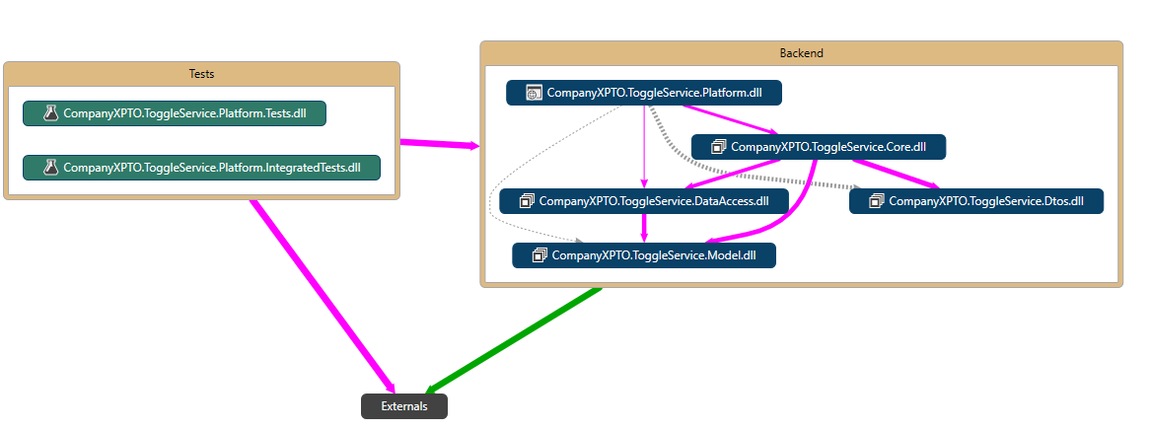
Architecture – Code Map for Solution

Slide 17
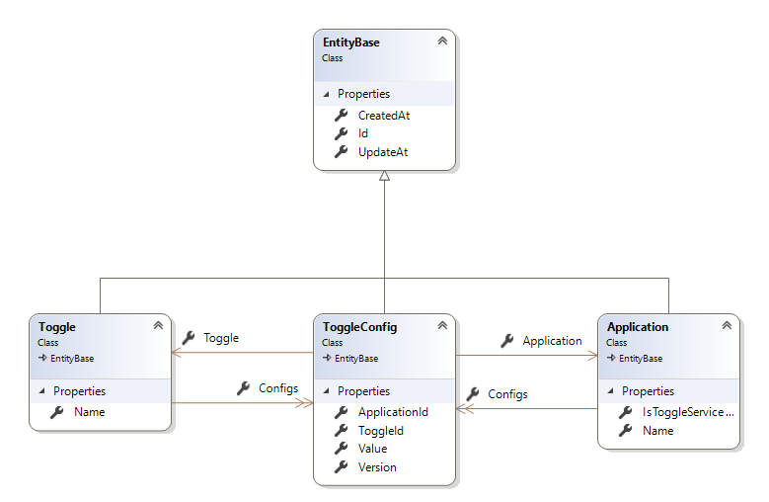
The class diagram from Model
The class diagram with the model from the platform is

Slide 18
The model
Description for each class define in model
Class | Description
Toggle | Define the entity to define the toggle feature from platform
Application | Define the entity to define the applications existing in system
ToggleConfig | Defines the entity that define the relationship between Toggle and Application, and its configurations (Version, Value – if toggle is on/off for the service,…)
EntityBase | Defines the entity base with common properties cross all model’s class.
Note: In real project it can be more complex because can have more configurations, requirements, …

Slide 19
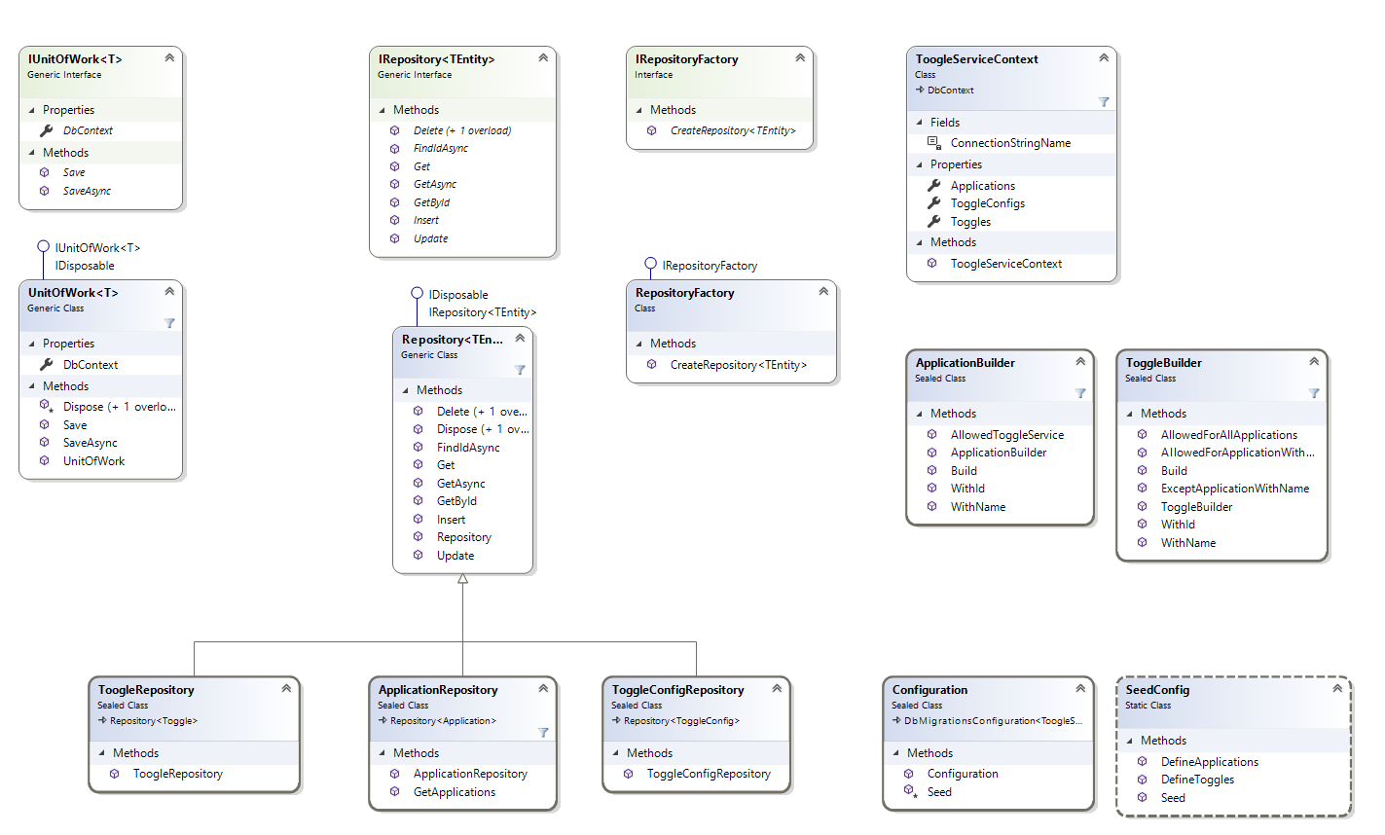
The class diagram from DataAccess project

Slide 20
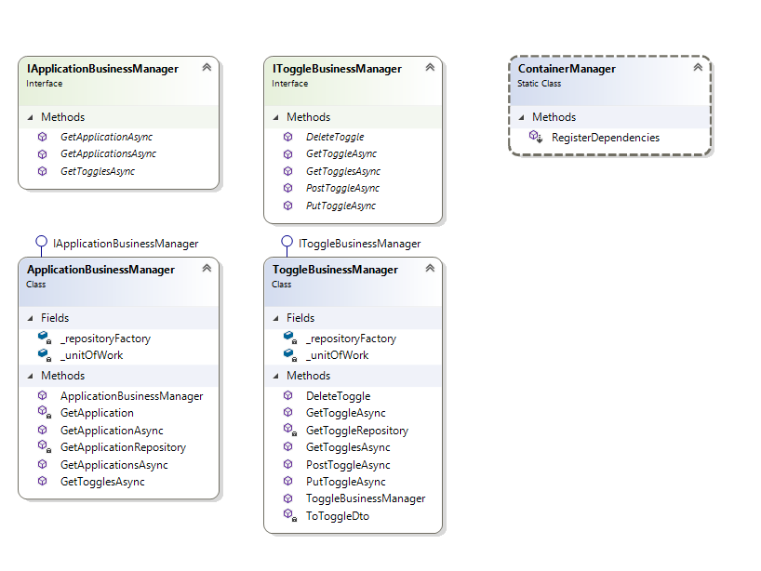
The class diagram from Core project

Slide 21
Desing Pattern
In the platform it was used differents design pattern:
Repository Pattern
UnitOfWork Pattern
Builder Pattern
Bridge Pattern
Factory Pattern
…
All dependencies were injected using SimpleInjector which are configured in IocConfig.cs and ContainerManager.cs.

Slide 22
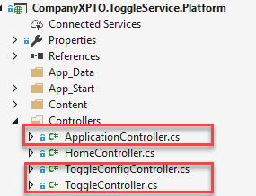
Services
The service are defined in Controllers folder:
ApplicationController – defines the application’s service (for CRUD operations)
ToggleController – defines the toggle’s service (for CRUD operations)
ToggleConfigController – define the service that allow to get toggle by application

Slide 23
Services - GetToggles by applicationId
http://toggleserviceplatform.azurewebsites.net/api/v1/ToggleConfig/{id}
[HttpGet]
[Route("{applicationId}")]
[AllowAnonymous]
[ResponseType(typeof(Response<IEnumerable<ToggleServiceConfigDto>>))]
public async Task<IHttpActionResult> GetTogglesAsync(string applicationId)
{
try
{
// the application id is always required
if (string.IsNullOrEmpty(applicationId))
{
// if application id is null the request is wrong
return BadRequest();
}
// get toggles configured in database from the applicationid provided
var result = await _applicationBusinessManager.GetTogglesAsync(applicationId);
return Ok(result);
}
catch (ArgumentOutOfRangeException e)
{
return NotFound();
}
catch (Exception ex)
{
// in some cases the exception could not be sent and it is only written in log system
return InternalServerError(ex);
}
}

Slide 24
Core - GetToggles by applicationId
ApplicationBusinessManager define the implementation used by service
public async Task<Response<IEnumerable<ToggleServiceConfigDto>>> GetTogglesAsync(string applicationId)
{
if (string.IsNullOrEmpty(applicationId))
{
throw new ArgumentNullException(nameof(applicationId));
}
var applicationRepository = GetApplicationRepository();
var application = await GetApplication(applicationId, applicationRepository);
if (!application.IsToggleServiceAllowed)
{
return new Response<IEnumerable<ToggleServiceConfigDto>> { IsValid = false , ErrorCode = "102", Message = $"{application.Name} does not have permission to use toggle service."};
}
var items = application.Configs?.Select(config => new ToggleServiceConfigDto
{
//●When the application/service request their toggles, they must only provide their id and version.
Id = config.ToggleId,
Version = config.Version
}).ToList() ?? new List<ToggleServiceConfigDto>();
return new Response<IEnumerable<ToggleServiceConfigDto>> { Result = items, IsValid = true };
}

Slide 25
Tests
In the project CompanyXPTO.ToggleService.Platform.Tests it was used the Moq framework to create mock data from each entity.
[TestMethod]
public async Task GetTogglesAsync_GetResponseWith2ToggleDtos_Ok()
{
var toggles = ToggleFakeData.GetToggles();
var unitoOfWorkMock = new Mock<IUnitOfWork<DbContext>>();
var repositoryMock = new Mock<IRepository<Toggle>>();
repositoryMock.Setup(r => r.GetAsync()).Returns(Task.FromResult(toggles));
var repositoryFactoryMock = new Mock<IRepositoryFactory>();
repositoryFactoryMock.Setup(r => r.CreateRepository<Toggle>(unitoOfWorkMock.Object)).Returns(repositoryMock.Object);
var manager = new ToggleBusinessManager(unitoOfWorkMock.Object, repositoryFactoryMock.Object);
var response = await manager.GetTogglesAsync();
Assert.IsNotNull(response);
Assert.IsNotNull(response.IsValid);
Assert.AreEqual(response.Result.Count(),2);
foreach (var item in response.Result)
{
Assert.IsNotNull(item.Name);
Assert.IsNotNull(item.Id);
Assert.IsNotNull(item.Applications);
}
}

Slide 26
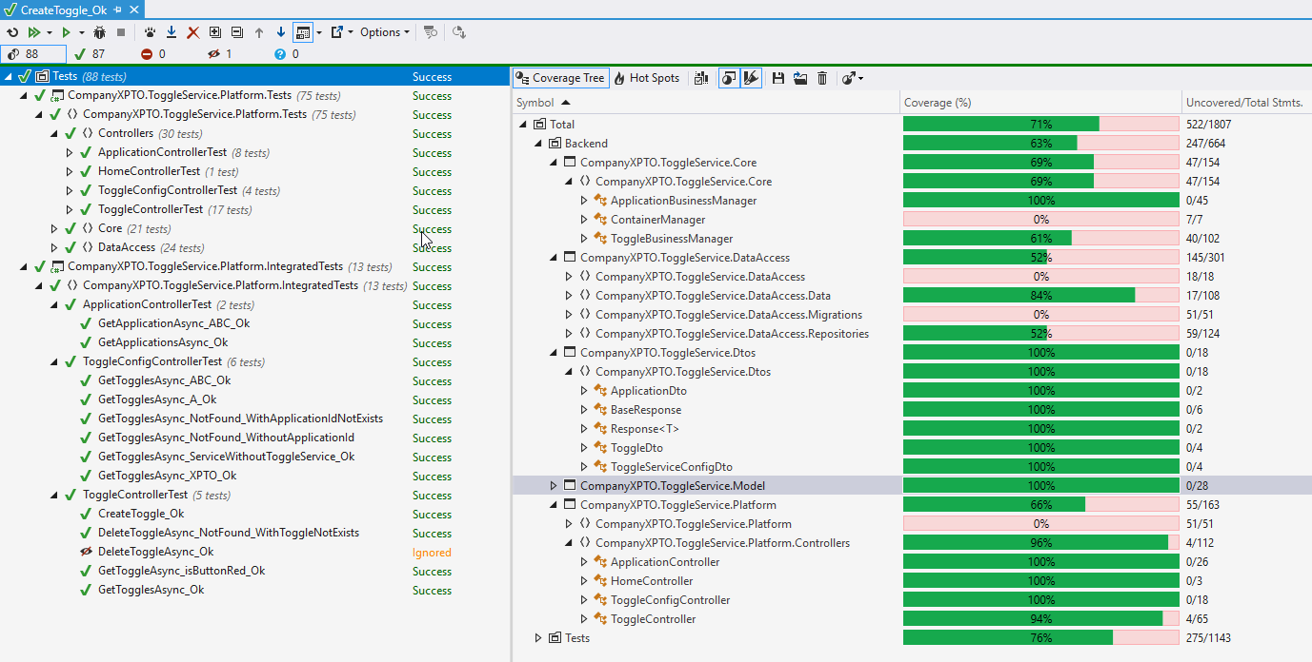
Code coverage results

Slide 27
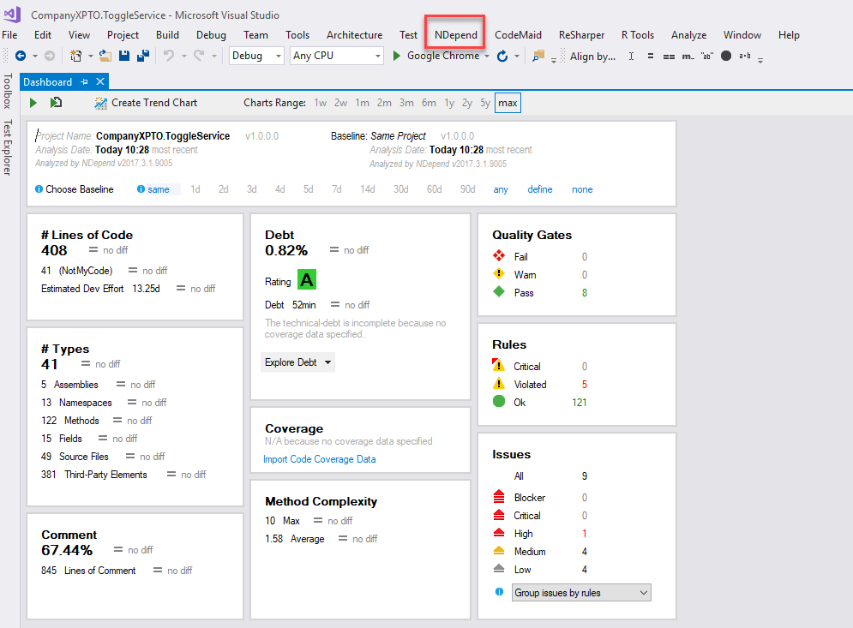
Code quality results
NDepend allow to analyze the quality code developed, in this case the Rating A is great, and in Rules there is 5 violed rules that is not possible to solve – we should change the query from NDepend to avoid these cases.
Note: See the NDepend output on src folder – a web based output

Slide 28
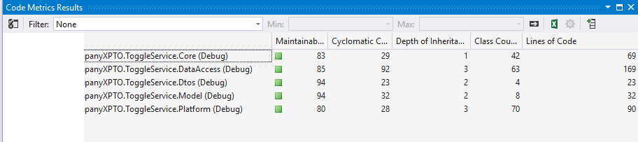
Code metrics result
The Maintainability index has high value which are good

Slide 29
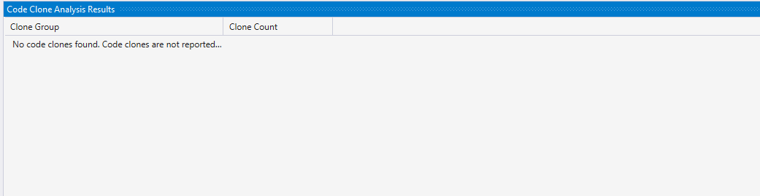
Code clone result

Slide 30
Considerations
“When setting a new toggle, only users with admin permission may create a toggle.”
It is all about authentication and authorization that is implemented using an method attribute in each controller’s method with the role permission.
There any solution to authentication – custom, external, social network, Company AD, Azure AD,…
To implement the authorization in a simple scenario the user can have a property that says the role type – admin, regular user, …
In my opinion I think it should be implement according the strategy defined and with a robust solution

Slide 31
Considerations
“Try to find a way to alert each client application/service that the toggle was changed.“
ASP.NET SignalR could be used to update the application/services when a toogle is changed, but I would like to recommend/test the Realtime framework - which is developed by portuguese company and it is focused in real-time communications

Slide 32
Considerations
API Helper - Swagger is a machine-readable representation of a RESTful API that enables support for interactive documentation, client SDK generation, and discoverability.
API Documentation - GhostDoc is a Visual Studio extension that automatically generates XML documentation comments for methods and properties based on their type, parameters, name, and other contextual information.
Logs – depending the server (on-promise or cloud) it should have a log strategy
Resources – depending the requirements the resources should be persisted in database to allow manage them using admin panel.
DevOps – Today there is any solutions to apply DevOps for a project, the solution provided has all necessary to apply it – only need a strategy to manage the database and data.
Two solutions I could use: Jenkins or Visual Studio Team Services

Slide 33
Aditional References
Related articles written by me and published on Microsoft TechNet Wiki
Class diagram: a easy way to understand code
Creating Framework Documentation with Ghostdoc
Analyzing C# code using NDepend
Some NetPonto presentation related with share and quality code
Como deixar de fazer "copy and paste" entre Windows Store e Windows Phone Apps
Como analizar o código C# com o NDepend

Slide 34
